Slide 1
okumu SKEP / oKIKE
Or the little alien that created earth

Slide 2

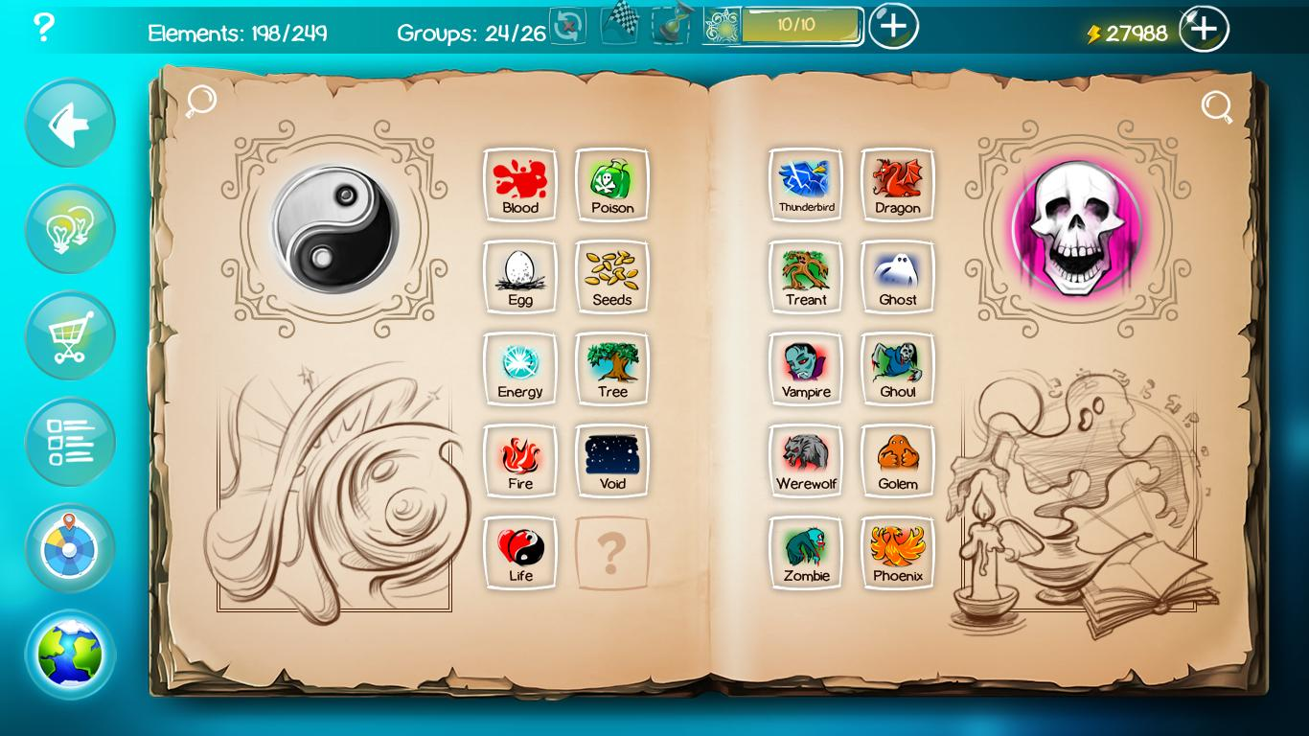
Main Inspiration
Doodle God (2010)
https://www.youtube.com/watch?v=noikl6ypI5c&t=23s

Slide 3

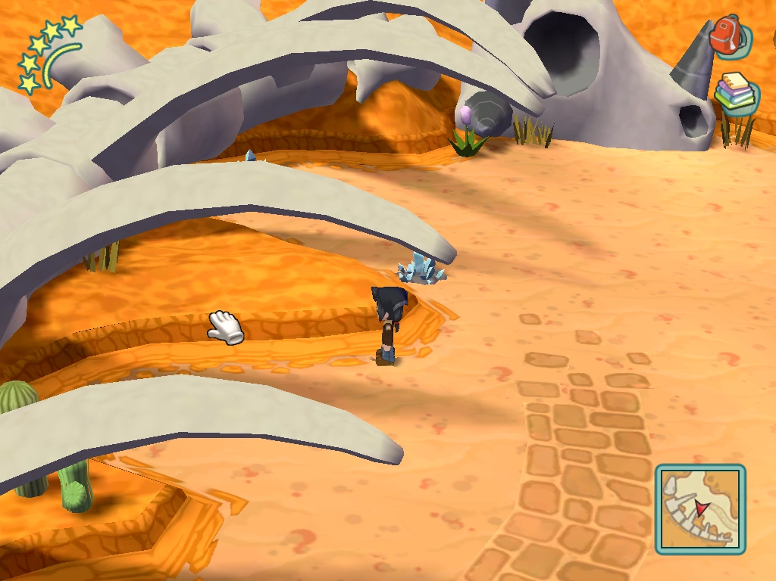
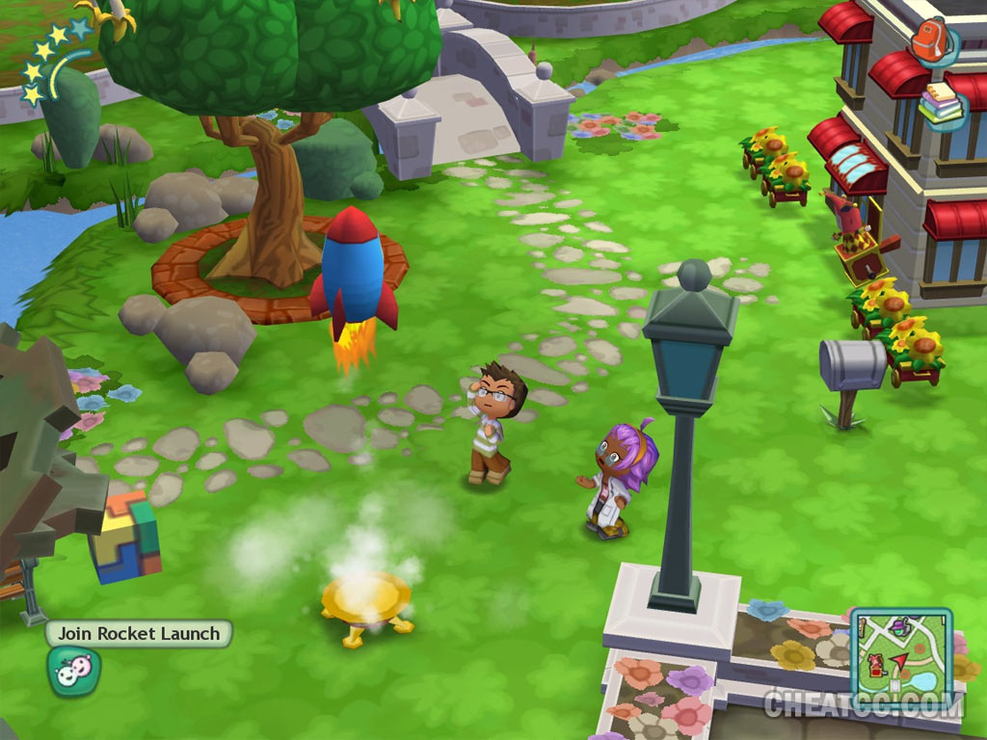
Secondary Inspiration
MySims (2007)

Slide 4
Game Description

Slide 5
Thought Process

Slide 6
Game Controls

Slide 7
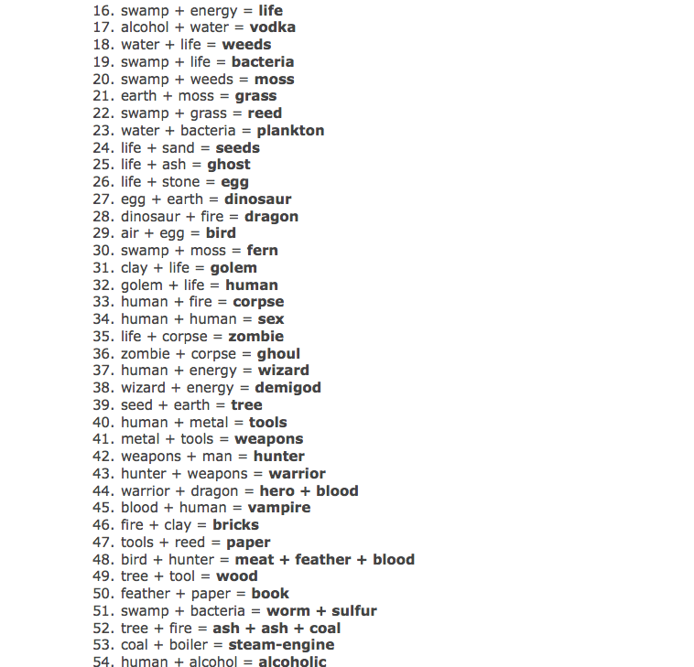
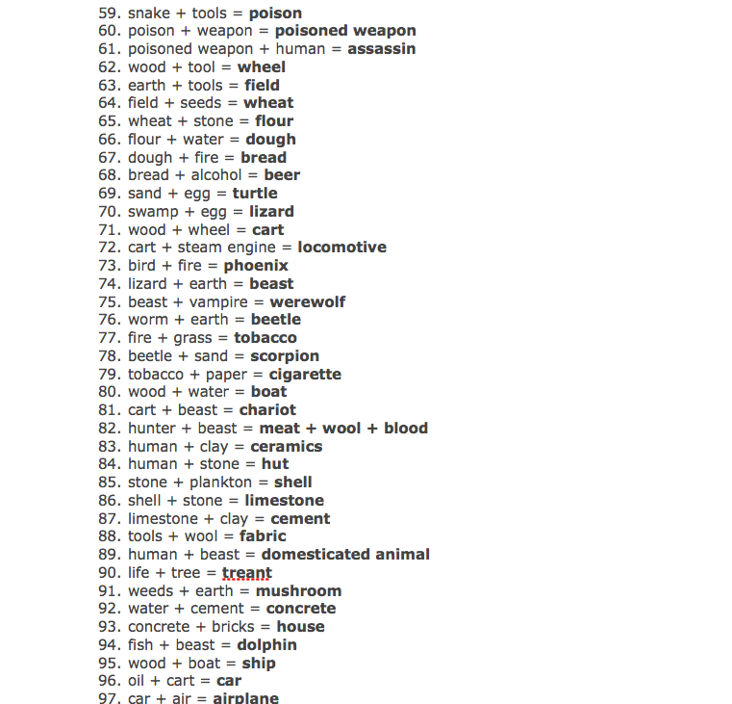
Triaging the Combinations
1. Eliminate combinations (106)

Slide 8
Triaging the Combinations
2. Make a visual schema
More combinations are added later on.

Slide 9
Triaging the Combinations
3. Integrating final combinations into gamespace

Slide 11
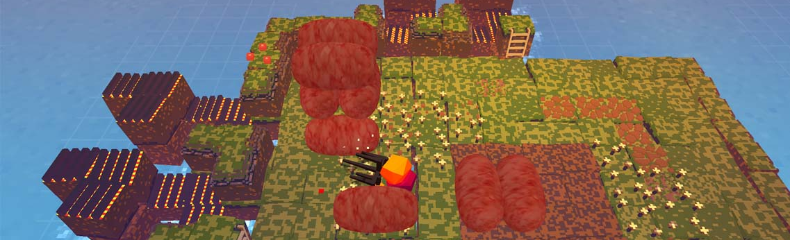
Visual Inspiration (Mechanics)
Stephen’s Sausage Roll
https://www.youtube.com/watch?v=6dsQtBHk0eE

Slide 12
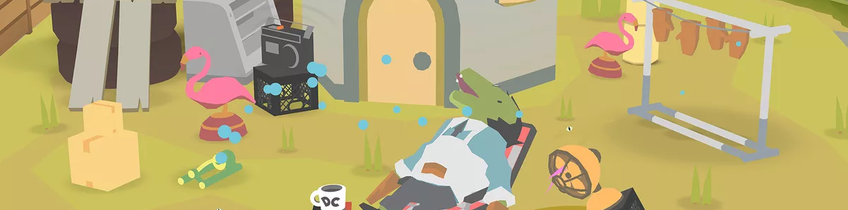

Visual Inspiration (Graphic Style)
Donut County

Slide 13
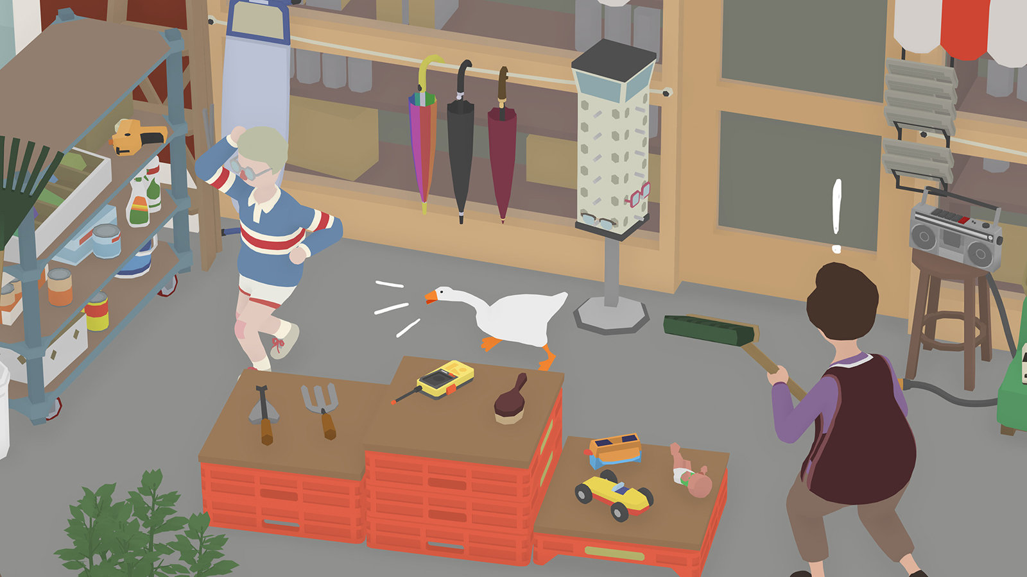
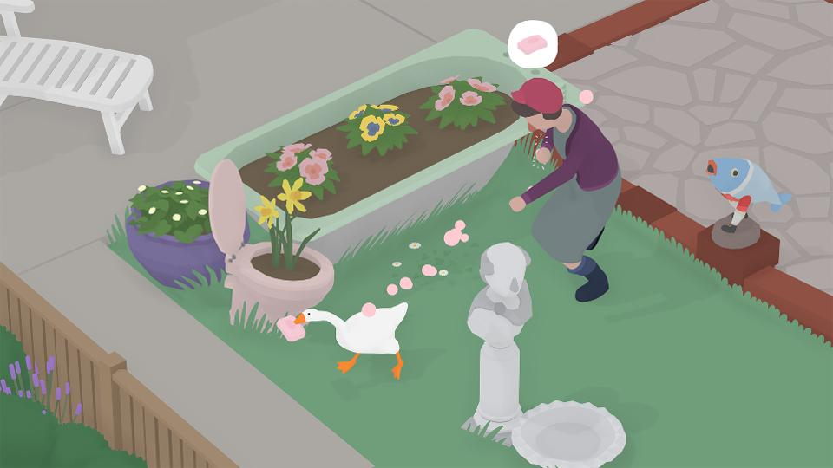
Visual Inspiration (Graphic Style)
Untitled Goose Game

Slide 14
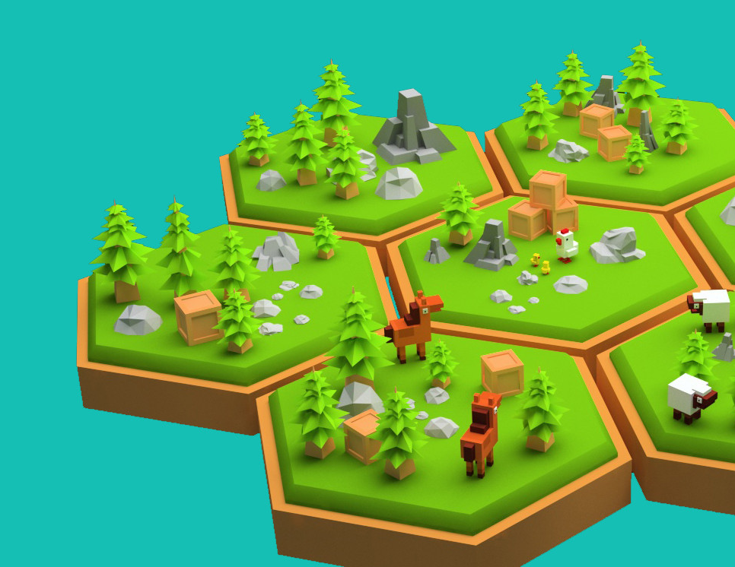
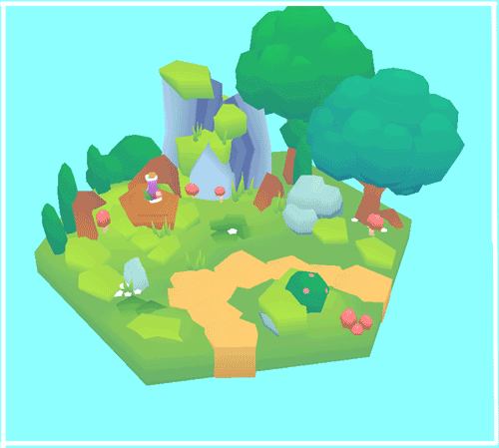
Visual Inspiration (World Structure)

Slide 15

Sketches (World Structure)

Slide 16
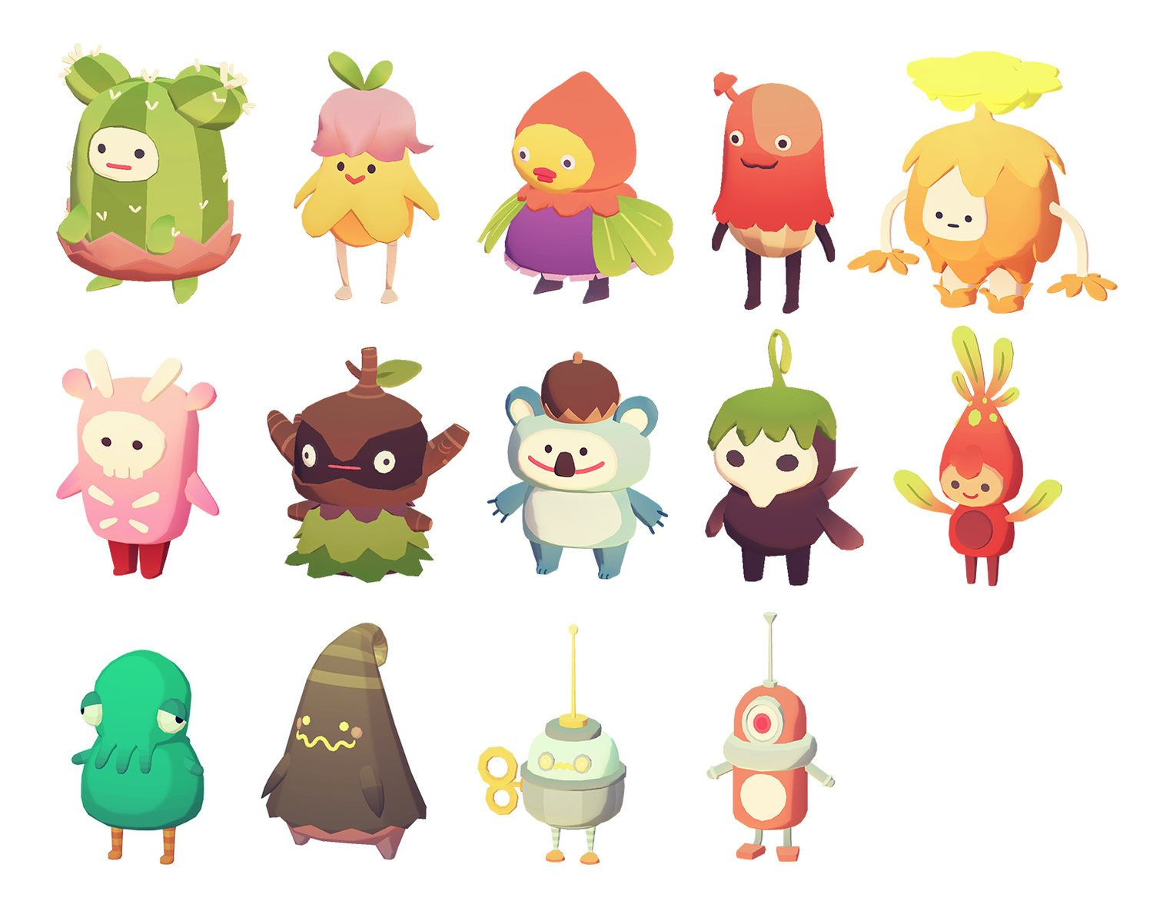
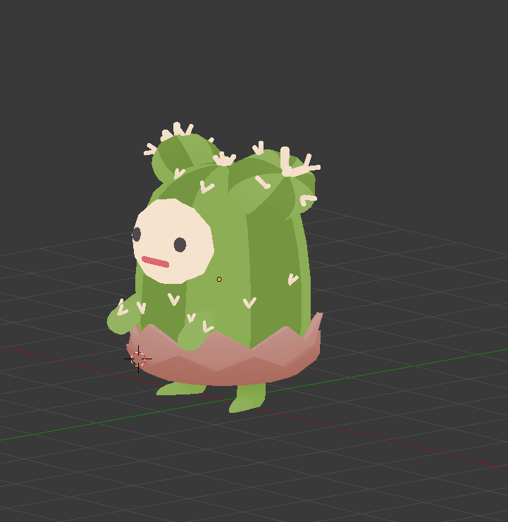
Visual Inspiration (Character)
Ooblets

Slide 17
Sketches (Character)

